Slide 1
LIVE COVID-19 UPDATE TRACKER
Group Member:
1) Vishal Joshi
2) Gajanan Gangakhedkar
3) Suraj Kadam
4) Vishal Waghmare

Slide 2
Index
Abstract
Hardware Requrement
Software Requirement
Project scope
Limitations
modules
data sourcs

Slide 3

Now days covid-19 is measure issue for us
number of new cases of COVID-19 is spreading up
So we need to get daily our surrounding covid19 cases updates.
Right now media does not giving proper time to time covod-19 updates.
So we Intruduced proper “Live Covid-19 Updets Tracker” we will provide you covid19 cases updates.

Slide 4
Hardware Requriement
Intel® Core™ i3 processor OR More
Disk space: 1 TB
RAM : 4 GB
Operating systems: Windows* 8,9 and 10 or later, macOS, and Linux.

Slide 5
Software Requirement
Front End: Python (3.9.0)
Pycharm community
OS : Windows / Linux / mac

Slide 6
Project scope
we will give you live covid-19 data updates.
we will provide all globel covidupdates.
Ex. how many covid-19 cases are recovered, death and active cases.
Interface is simple.
This project for everyones use .
it is userfriendly.
It is secure.

Slide 7
Limitations.
Internet needed.
sometime geting time to load updates.

Slide 8
Modules
requests module
beautifulsoup4u module

Slide 9
Data sourcs
The data is validated by Google sheet and an API. API is available for all at api.https://www.worldometers.info/coronavirus/.

Slide 10
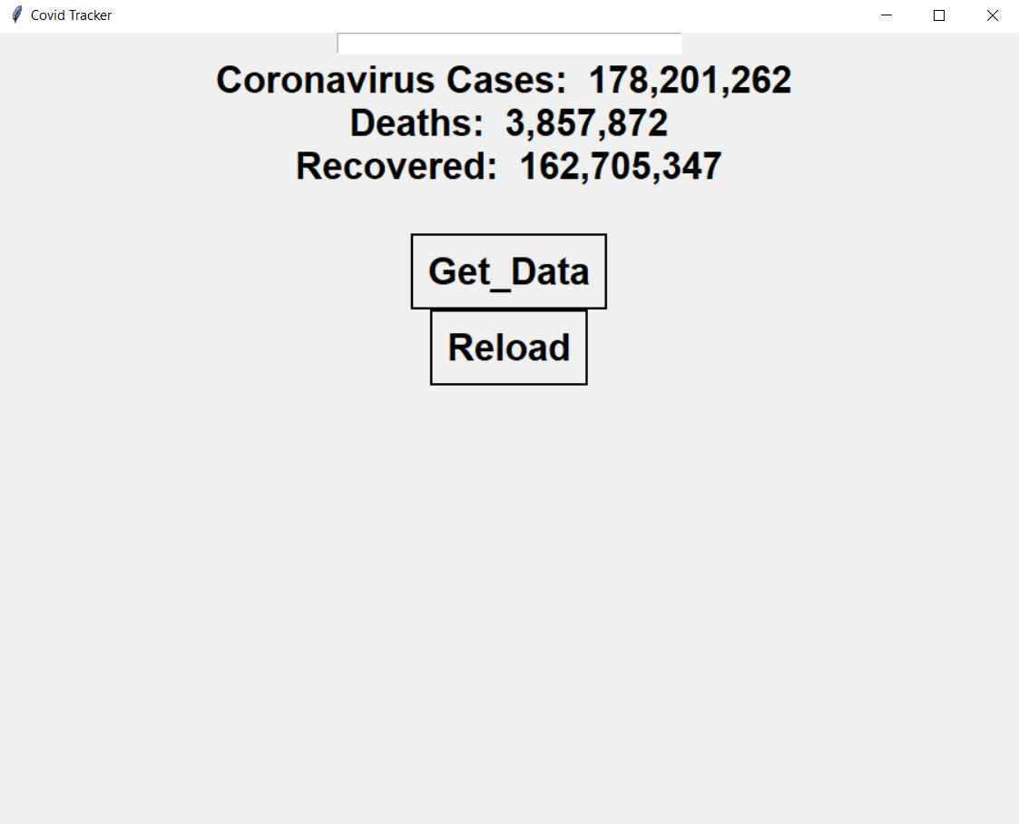
IMPLEMENTATION

Slide 11
.
Thank you

